Slide 1
CMSC204
Kartchner
By: Marcus Brooks
V(StateGraph) = {Oregon, Alaska, Texas, Hawaii, Vermont, NewYork, California}
E(StateGraph) = {(Alaska, Oregon), (Hawaii, Alaska), (Hawaii, Texas), (Texas, Hawaii), (Hawaii, California), (Hawaii, New York), (Texas, Vermont), (Vermont, California), (Vermont, Alaska)}
1. Draw the StateGraph
Alaska
Oregon
Hawaii
California
Texas
New York
Vermont

Slide 2
a. Show the adjacency matrix that would describe the edges in the graph. Store the vertices in alphabetical order
States
 | Alaska | California | Hawaii | New York | Oregon | Texas | Vermont
Alaska | 0 | 0 | 0 | 0 | 1 | 0 | 0
California | 0 | 0 | 0 | 0 | 0 | 0 | 0
Hawaii | 1 | 1 | 0 | 1 | 0 | 1 | 0
New York | 0 | 0 | 0 | 0 | 0 | 0 | 0
Oregon | 0 | 0 | 0 | 0 | 0 | 0 | 0
Texas | 0 | 0 | 1 | 0 | 0 | 0 | 1
Vermont | 1 | 1 | 0 | 0 | 0 | 0 | 0
Alaska
California
Hawaii
New York
Oregon
Texas
Vermont
3. b. Show the adjacency lists
that would describe the edges in the graph
Alaska
Oregon
California
Hawaii
Alaska
California
New York
Texas
New York
Oregon
Texas
Hawaii
Vermont
Vermont
Alaska
California

Slide 3
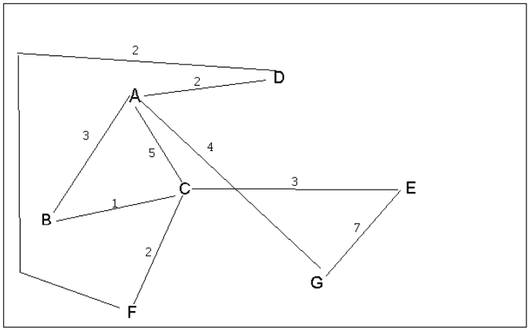
4 a. Which of the following lists the graph nodes in depth first order beginning with E?
A) E, G, F, C, D, B, A
B) G, A, E, C, B, F, D
C) E, G, A, D, F, C, B <- C is my answer
D) E, C, F, B, A, D, G
4 b. Which of the following lists the graph nodes in breadth first order beginning at F?
A) F, C, D, A, B, E, G <- A is my answer
B) F, D, C, A, B, C, G
C) F, C, D, B, G, A, E
D) a, b, and c are all breadth first traversals

Slide 4
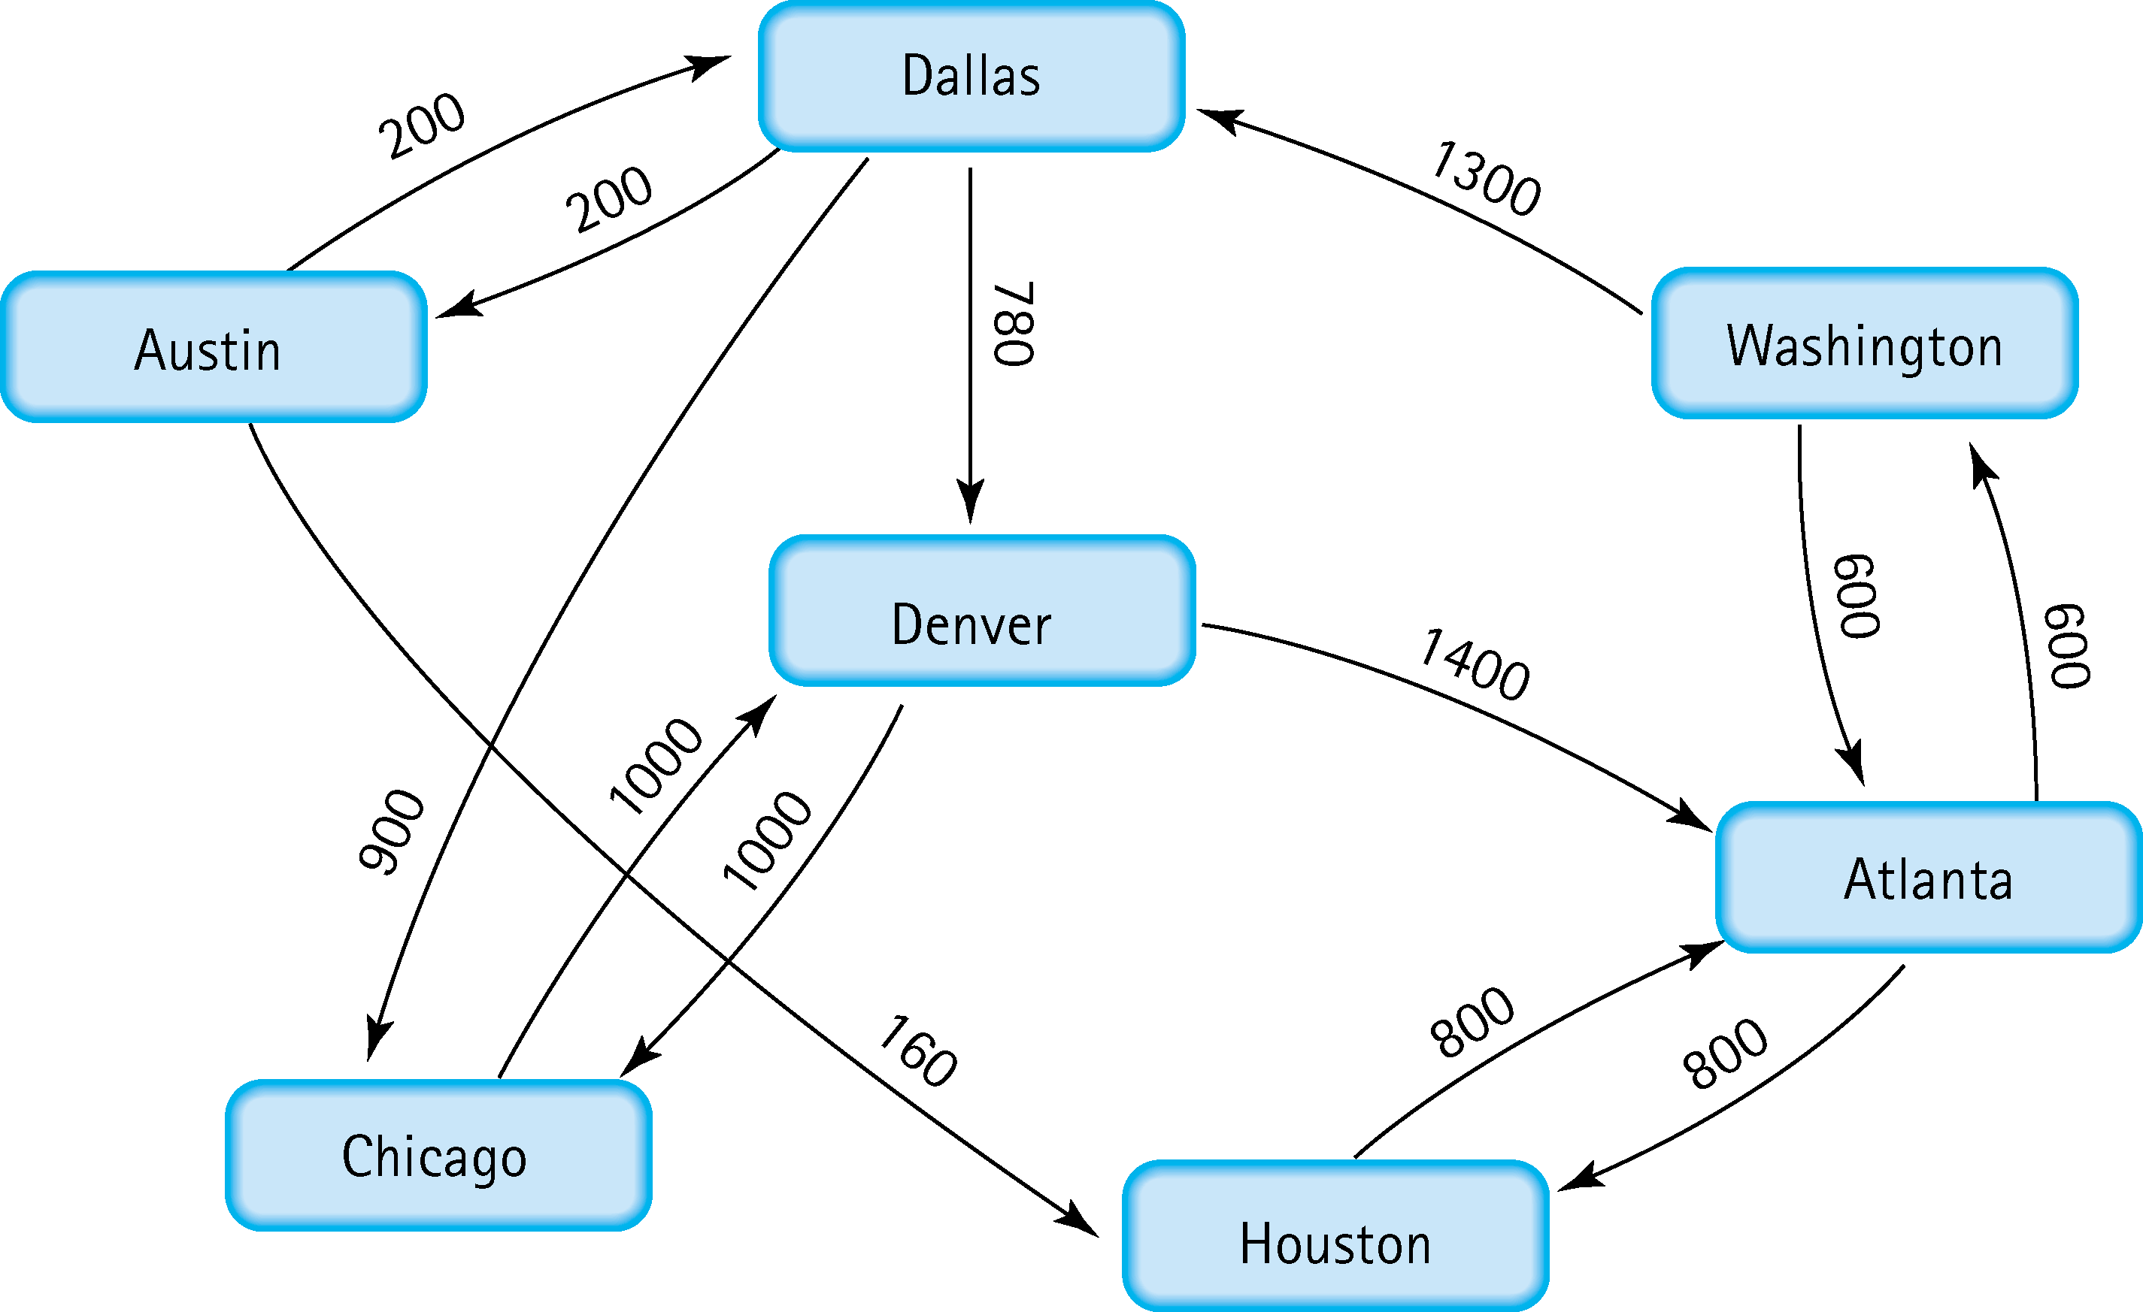
5. Find the shortest distance from Atlanta to every other city
Atlanta – Washington (600)
Atlanta – Dallas (1900)
Atlanta – Houston (800)
Atlanta – Denver (2680)
Atlanta – Austin (2100)
Atlanta – Chicago (2800)

Slide 5
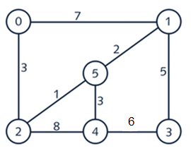
6. Find the minimal spanning tree using Prim’s algorithm. Use
0 as the source vertex . Show the steps.
MST Chosen Path
Considered

Slide 6
7. Find the minimal spanning tree using Kruskal’s algorithm.
Show the weights in order and the steps.
First list the edges
0 – 1 (7)
0 – 2 (3)
1 – 3 (5)
1 – 5 (2)
2 – 5 (1)
2 – 4 (8)
3 – 4 (6)
4 – 5 (3)
Then list the edges in order by weight
2 – 5 (1)
1 – 5 (2)
0 – 2 (3)
4 – 5 (3)
1 – 3 (5)
3 – 4 (6)
0 – 1 (7)
2 – 4 (8)
Then determine the least cost edge to each vertice by iterating over the list and determining if there is already a connection to the nodes involved
2 – 5 (1) <- Added
1 – 5 (2) <- Added
0 – 2 (3) <- Added
4 – 5 (3) <- Added
1 – 3 (5) <- Added
3 – 4 (6) x not needed
0 – 1 (7) x not needed
2 – 4 (8) x not needed

Slide 7
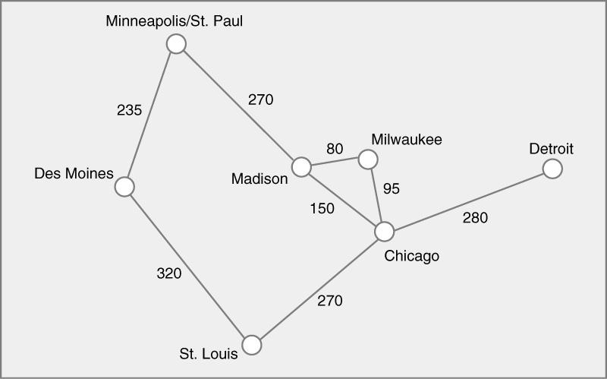
8. Find the minimal spanning tree using the algorithm you prefer. Use
Minneapolis/St. Paul as the source vertex

Slide 8
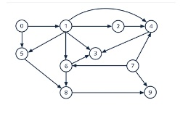
9. List the nodes of the graph in a breadth first topological ordering. Show the
steps using arrays predCount, topologicalOrder and a queue
Pred count
Pred count
0 | 1 | 1 | 3 | 3 | 2 | 2 | 0 | 2 | 2
0 | 0 | 1 | 3 | 3 | 1 | 2 | 0 | 2 | 2
Topological Order
Topological Order
0
Queue
Queue
0 | 7
7 | 1
Pred count
Pred count
0 | 0 | 1 | 3 | 2 | 1 | 1 | 0 | 2 | 1
0 | 0 | 0 | 2 | 1 | 0 | 0 | 0 | 2 | 1
Topological Order
Topological Order
0 | 7
0 | 7 | 1
Queue
Queue
1
2 | 5 | 6

Slide 9
CONTINUED
Pred count
0 | 0 | 0 | 2 | 0 | 0 | 0 | 0 | 2 | 1
Topological Order
0 | 7 | 1 | 2
Queue
5 | 6 | 4
Pred count
Pred count
0 | 0 | 0 | 2 | 0 | 0 | 0 | 0 | 1 | 1
0 | 0 | 0 | 1 | 0 | 0 | 0 | 0 | 0 | 1
Topological Order
Topological Order
0 | 7 | 1 | 2 | 5
0 | 7 | 1 | 2 | 5 | 6
Queue
Queue
6 | 4
4 | 8
Pred count
Pred count
0 | 0 | 0 | 0 | 0 | 0 | 0 | 0 | 0 | 1
0 | 0 | 0 | 0 | 0 | 0 | 0 | 0 | 0 | 0
Topological Order
Topological Order
0 | 7 | 1 | 2 | 5 | 6 | 4
0 | 7 | 1 | 2 | 5 | 6 | 4 | 8
Queue
Queue
8 | 3
3 | 9
ANSWER
Pred count
Pred count
0 | 0 | 0 | 0 | 0 | 0 | 0 | 0 | 0 | 0
0 | 0 | 0 | 0 | 0 | 0 | 0 | 0 | 0 | 0
Topological Order
Topological Order
0 | 7 | 1 | 2 | 5 | 6 | 4 | 8 | 3
0 | 7 | 1 | 2 | 5 | 6 | 4 | 8 | 3 | 9
Queue
Queue
9

Slide 10
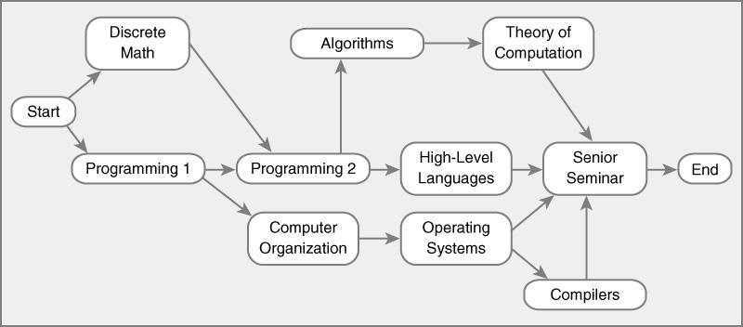
10. List the nodes of the graph in a breadth first topological ordering.
Start, Discrete Math, Programming 1, Programming 2, Computer Organization, Algorithms, High-Level Languages, Operating Systems, Theory of Computation, Compilers, Senior Seminar, End

